Slide 1



Fi INTERIORSTM
Custom Acoustic Décor Solutions
www.fabricimages.com/fi-interiors
©2022 Fabric Images, Inc.® All Rights Reserved.

Slide 2
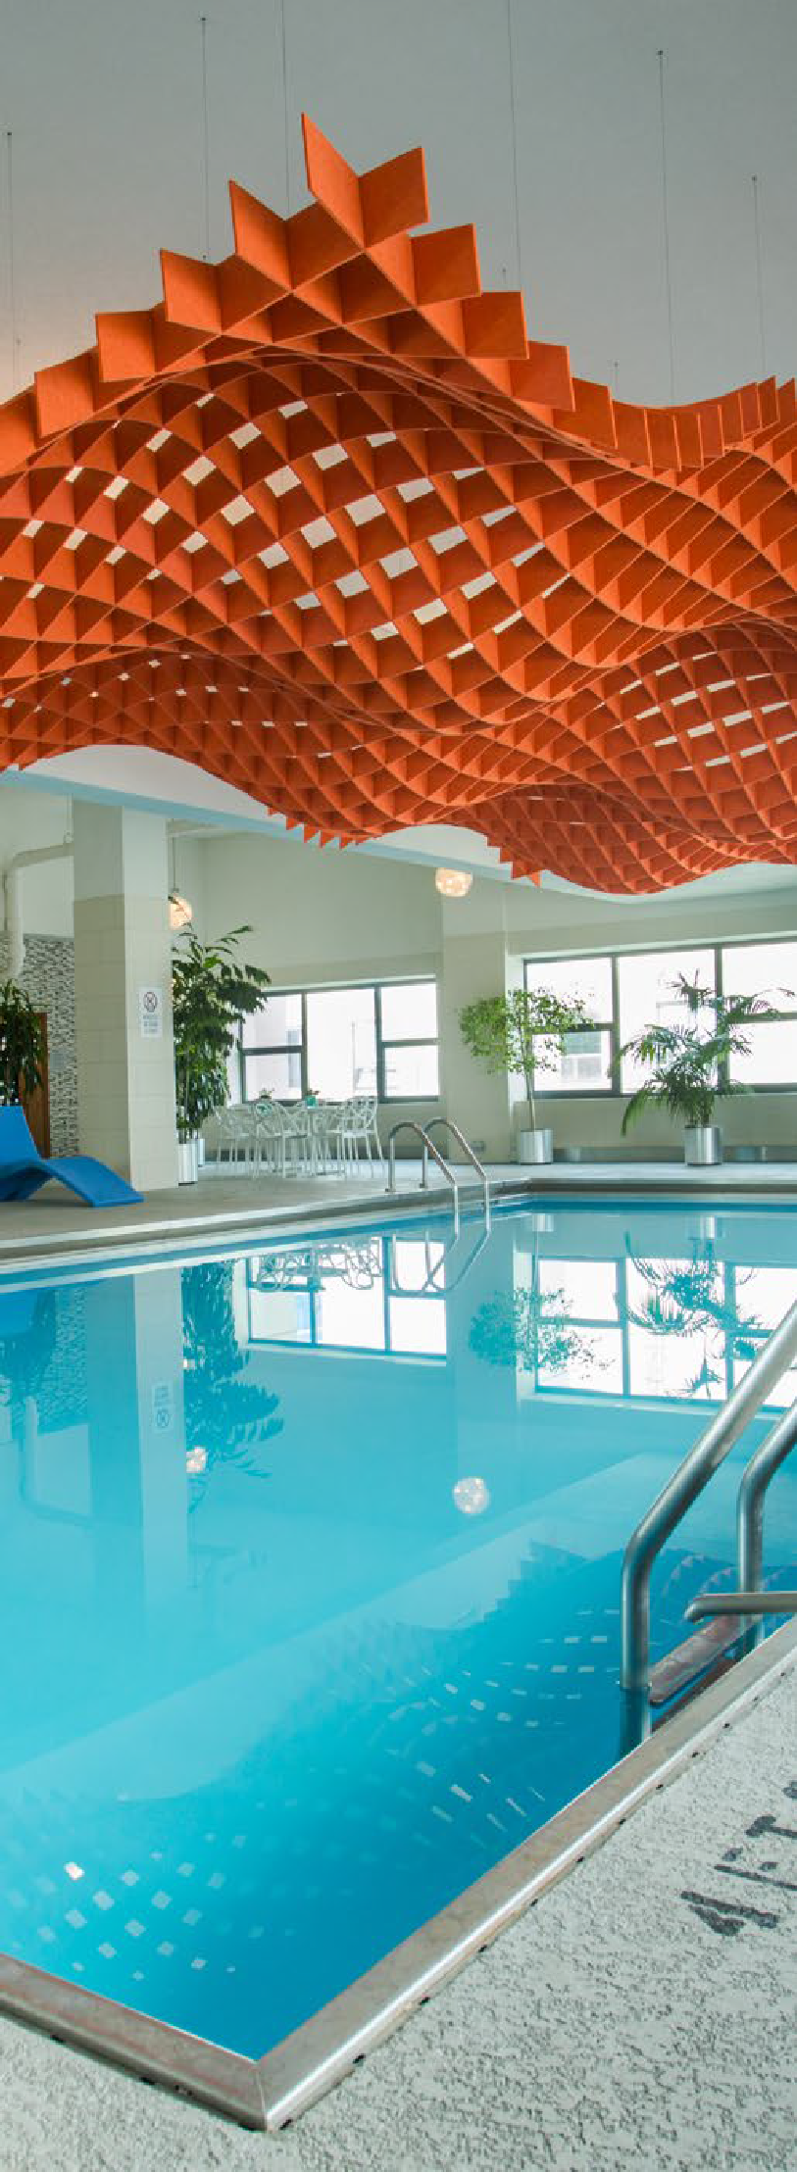
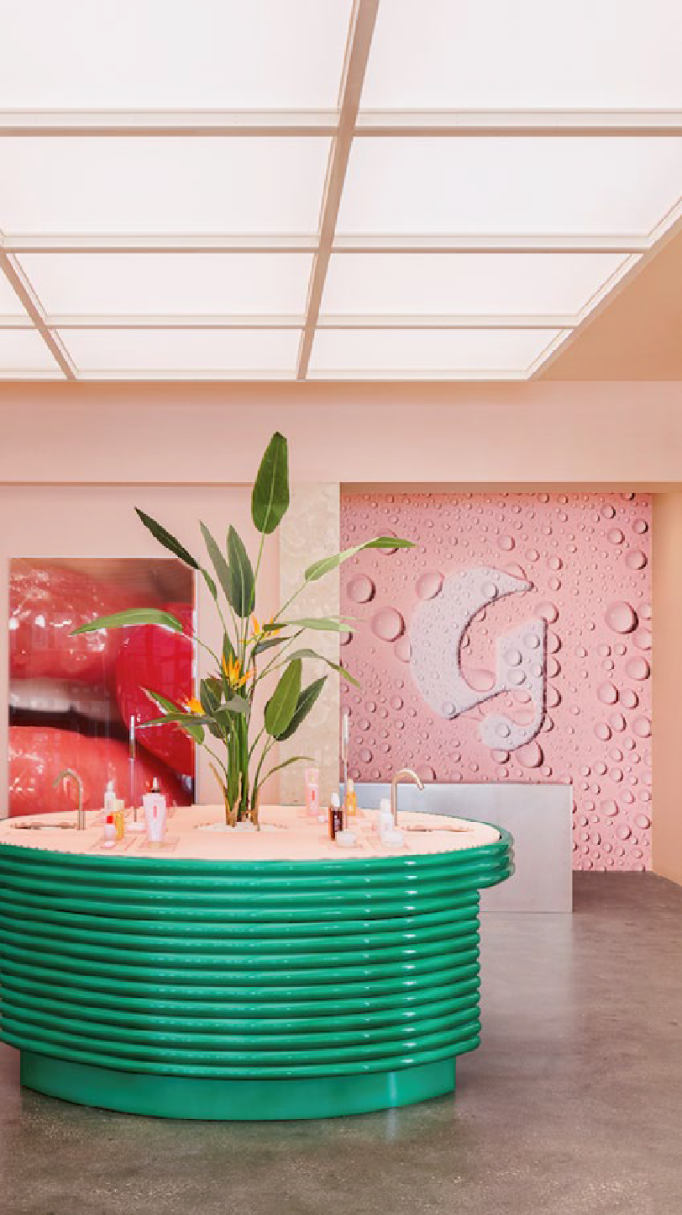
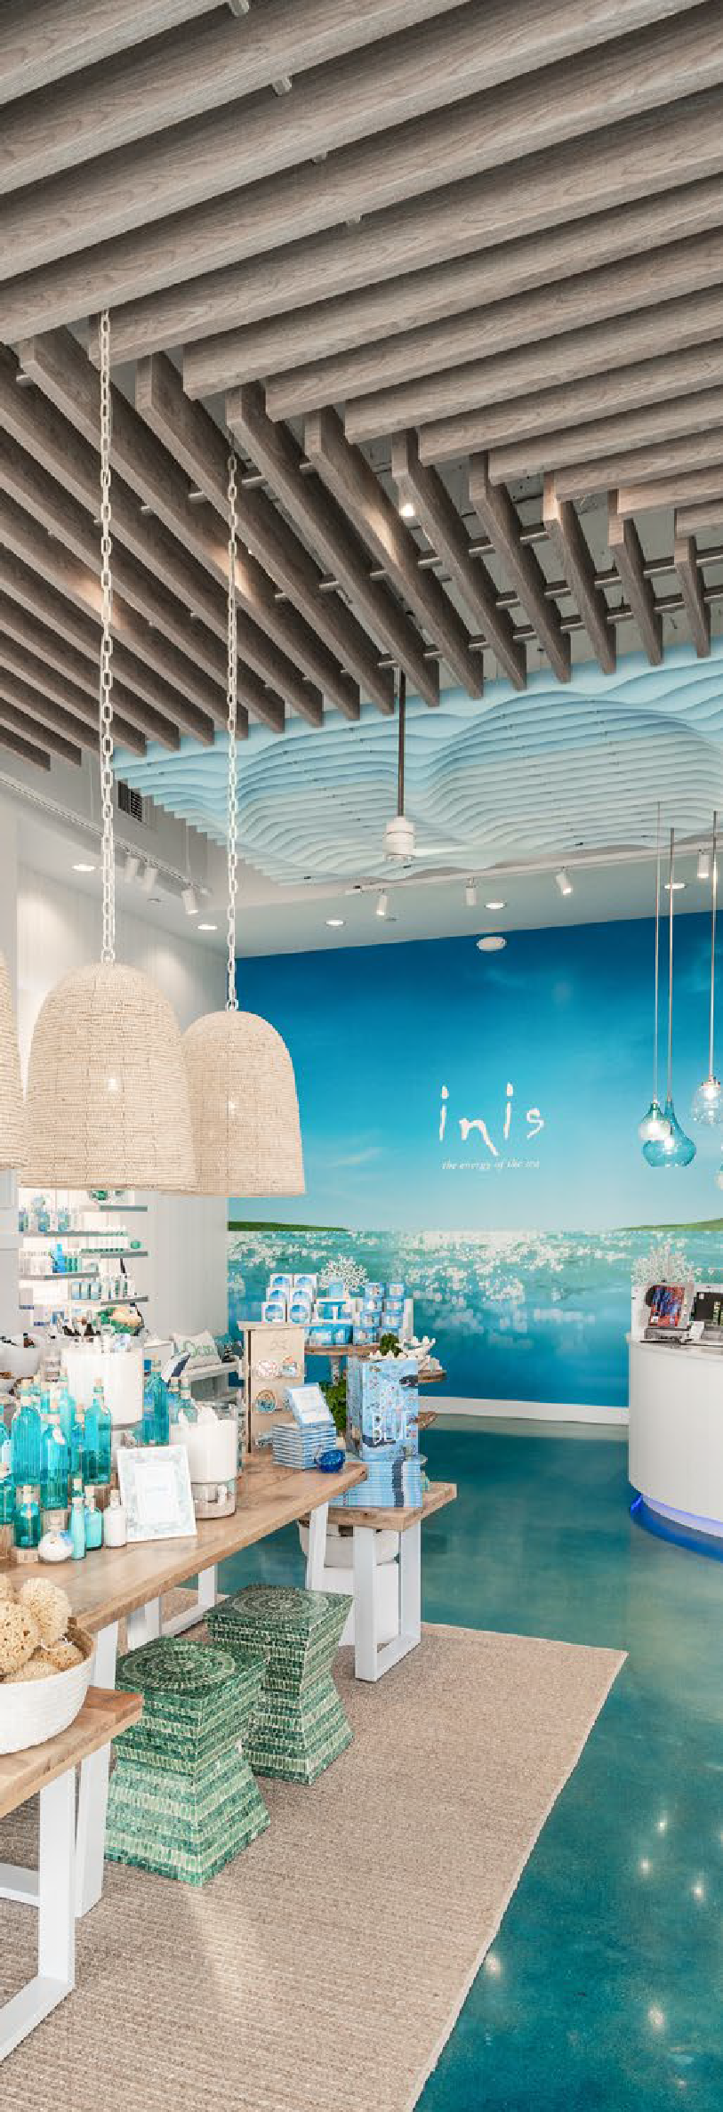
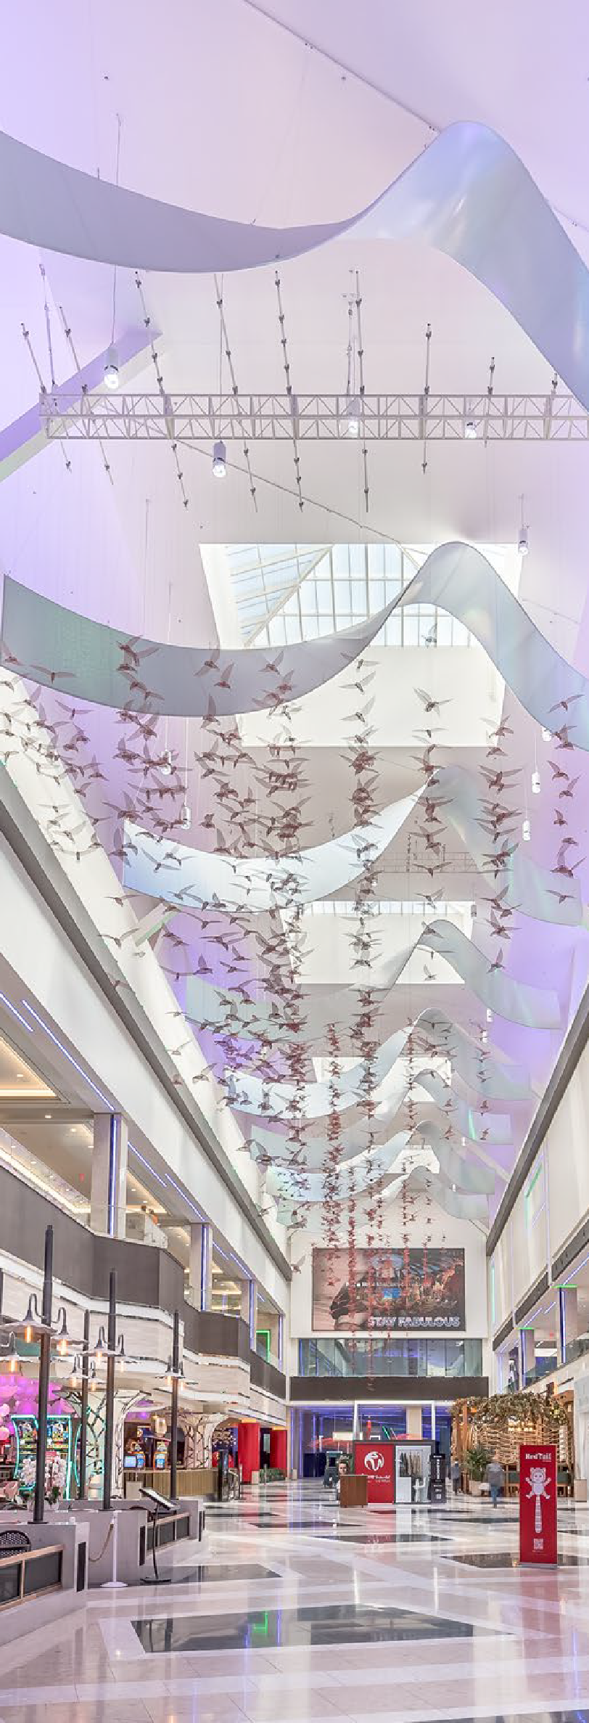
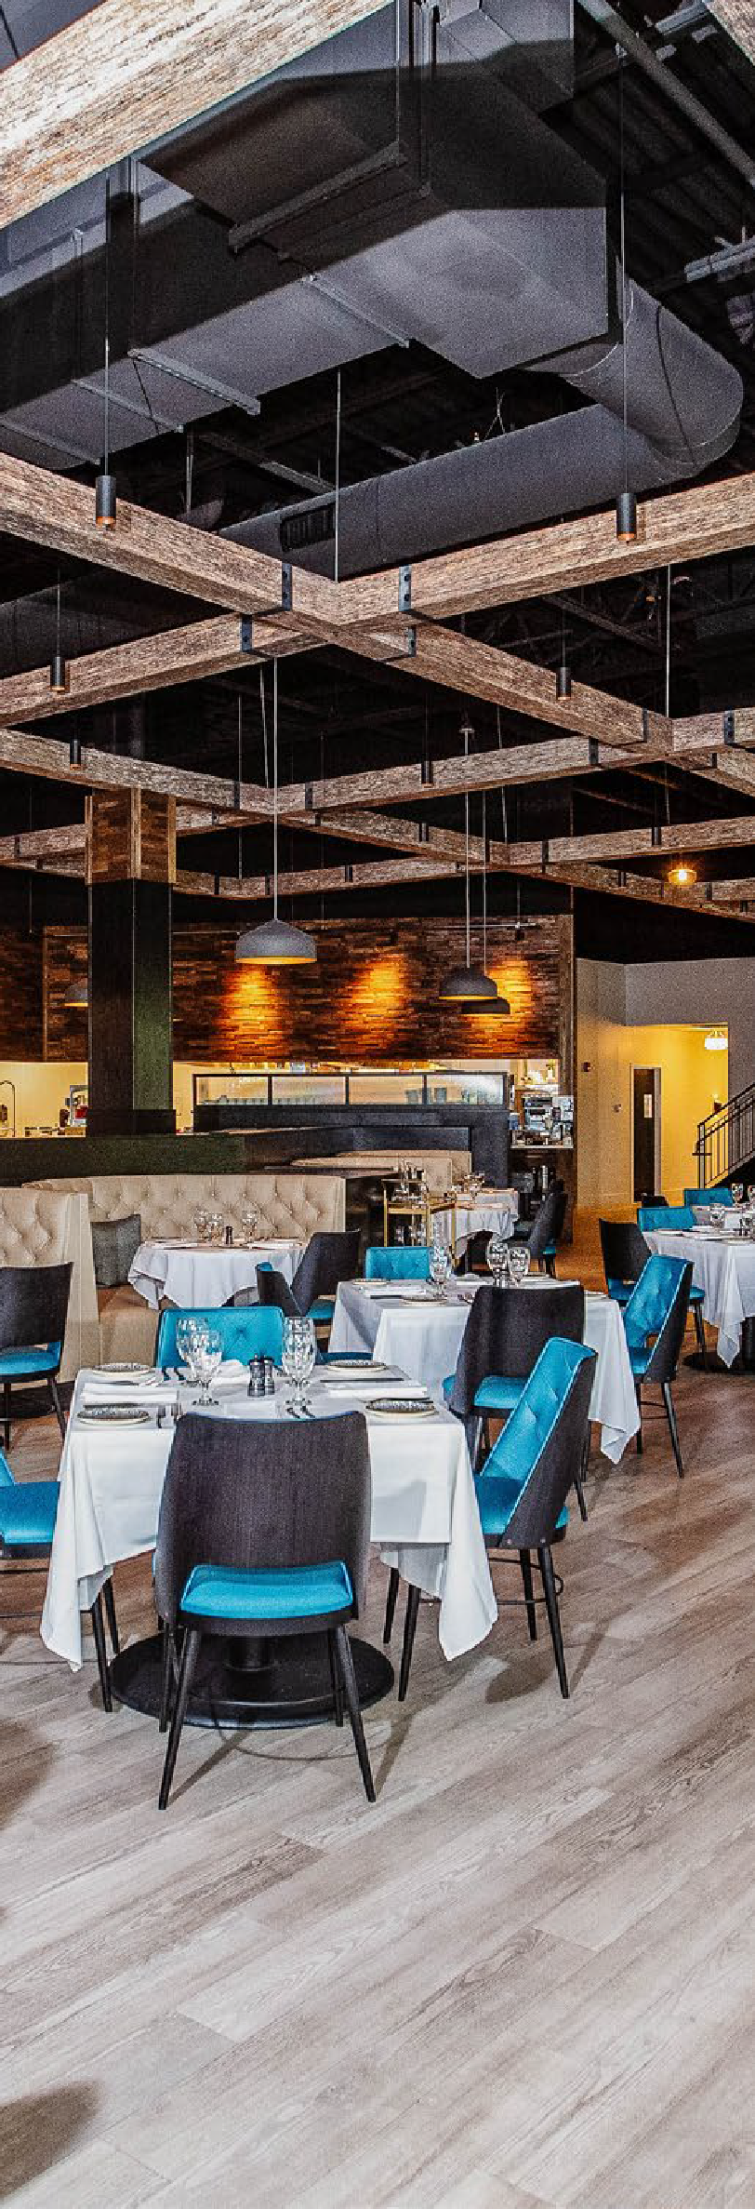

FABRIC IMAGESTM
Design-centric manufacturer of tension fabric architecture, acoustical décor products, and custom interior design solutions, providing architects and designers with a range of products, materials, and capabilities to bring life to their vision.

Slide 3
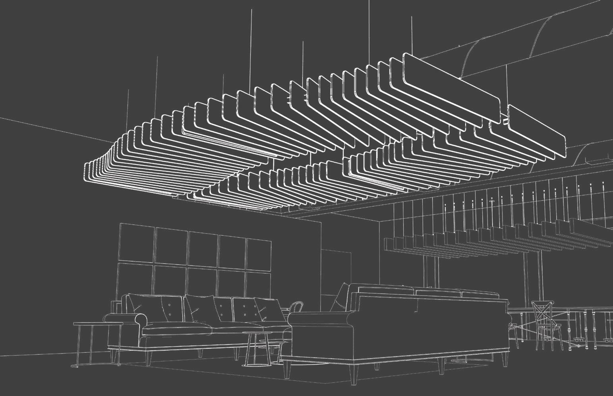
A COLLABORATIVE PARTNER
We understand the complexities of designing an environment that’ll deliver the intended experience and meet the expected budget.
We offer a range of services to support, guide, or drive a project from concept to completion, including...
Design inspiration
Material selection
Solution development
Value engineering
Installation support

Slide 4
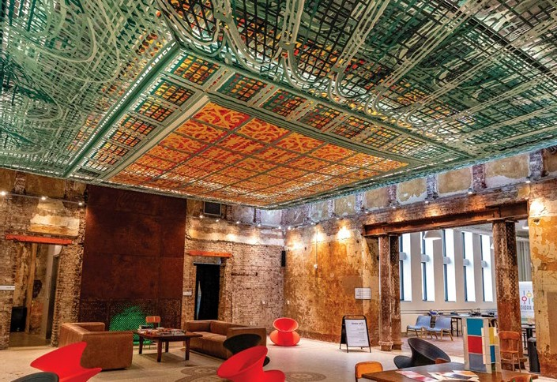
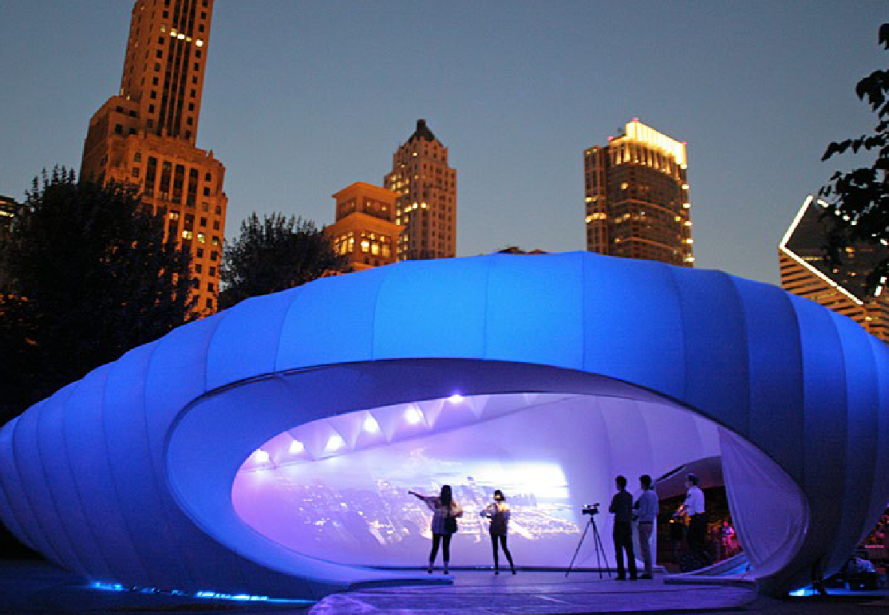
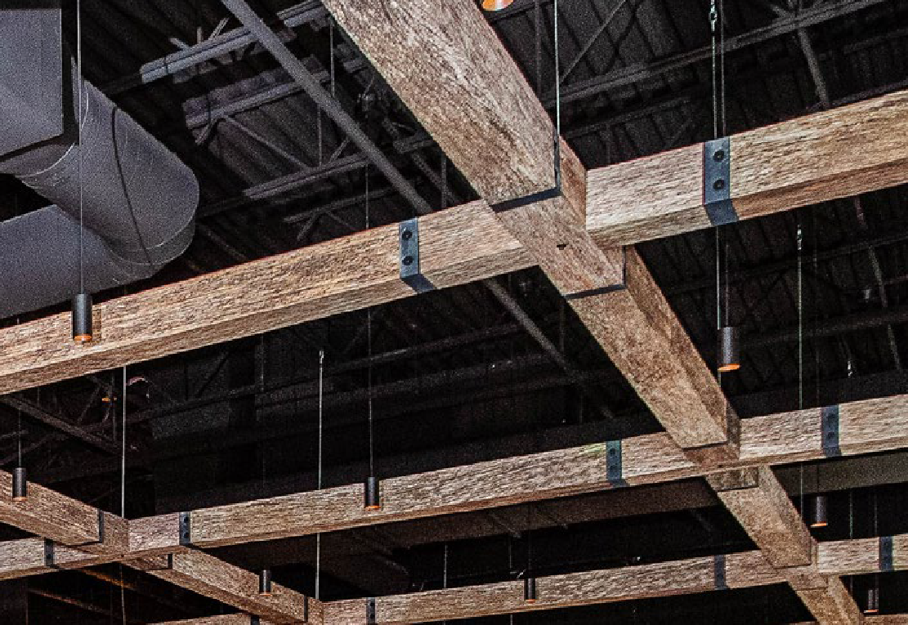
MATERIAL EXPERTS
Budget and materials can often limit a design.
That’s why we use highly versatile and cost-effective materials that we can sculpt to fit any space or budget.
Capabilities include...
Acoustical interior décor
Frame and fabric architecture
Tension fabric and textile finishing
Digital printing
Metal engineering and fabrication
Lighting integration
Custom woodworking

Slide 5







MARKET FOCUSED
Fabric Images is comprised of three studios, each focused on the unique needs of the markets they serve.
Interior décor products and custom solutions for the A&D industry.
Custom fabric architecture and material solutions for trade shows and events.
Custom material solutions that support the brand story in a retail space.

Slide 6
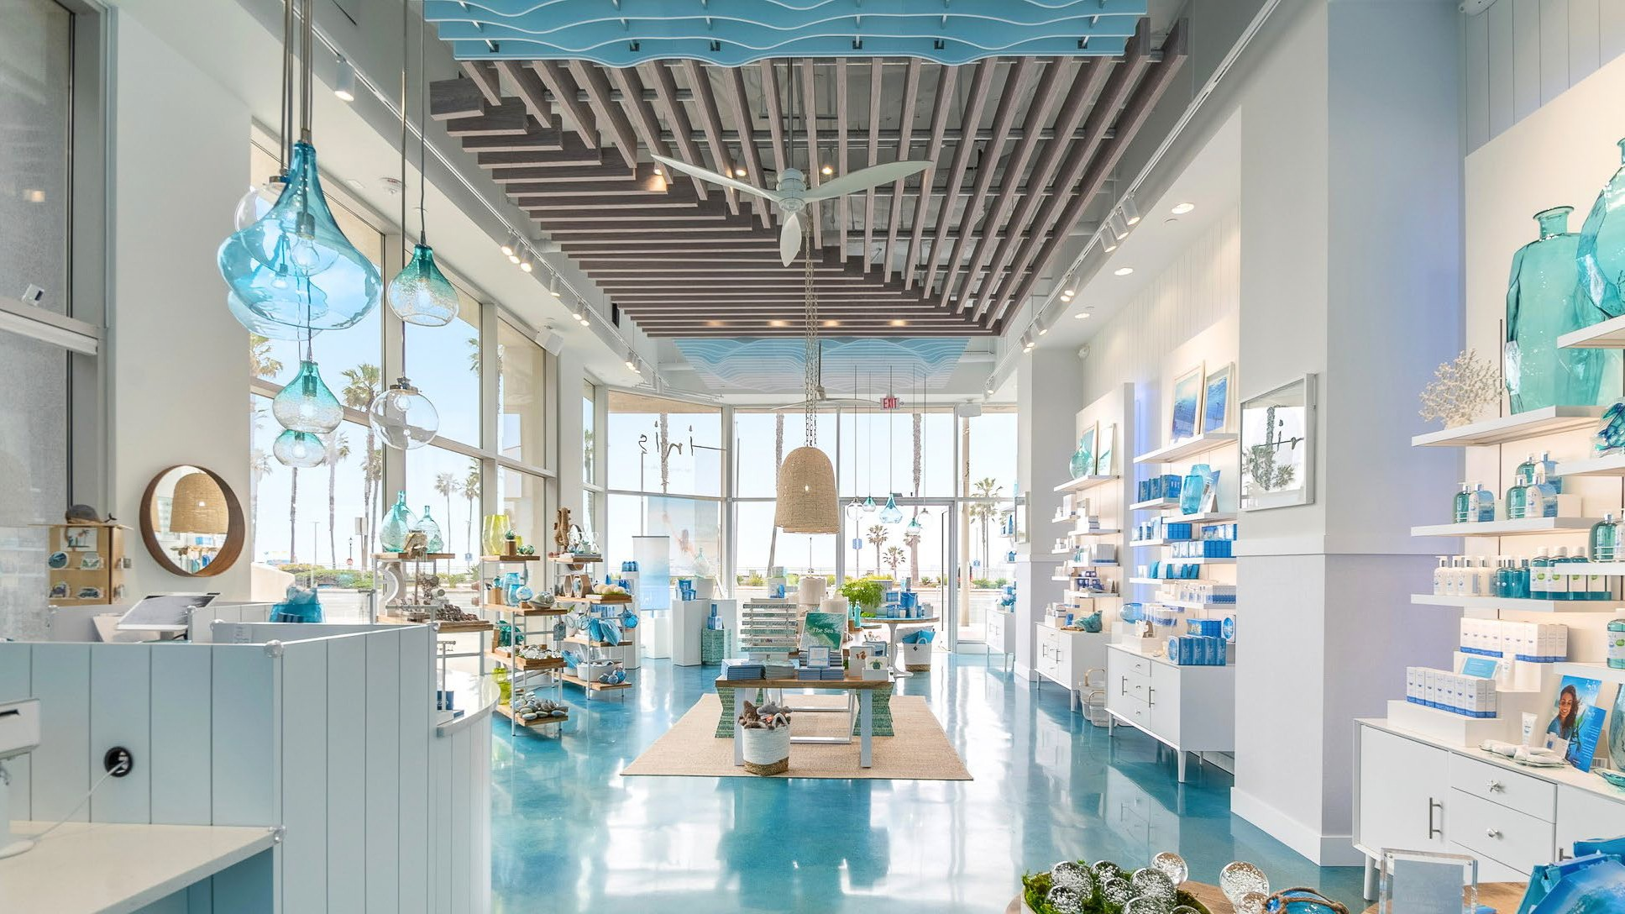


Fi INTERIORSTM
Designs and manufactures acoustic interior décor products and custom solutions that connect to the essence of the environment, brand, or experience.

Slide 7
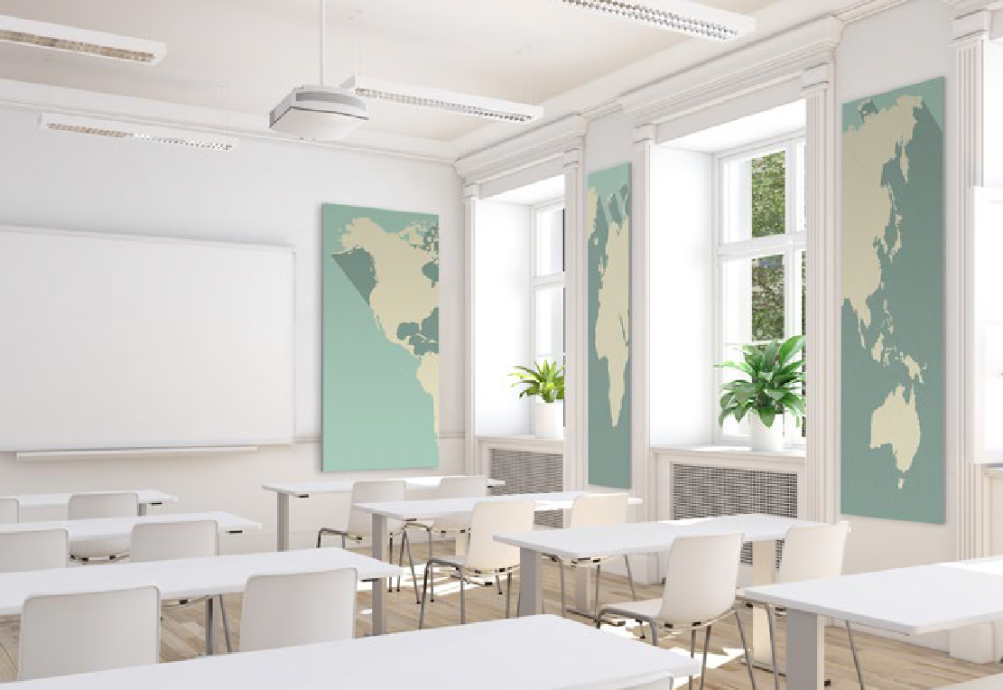
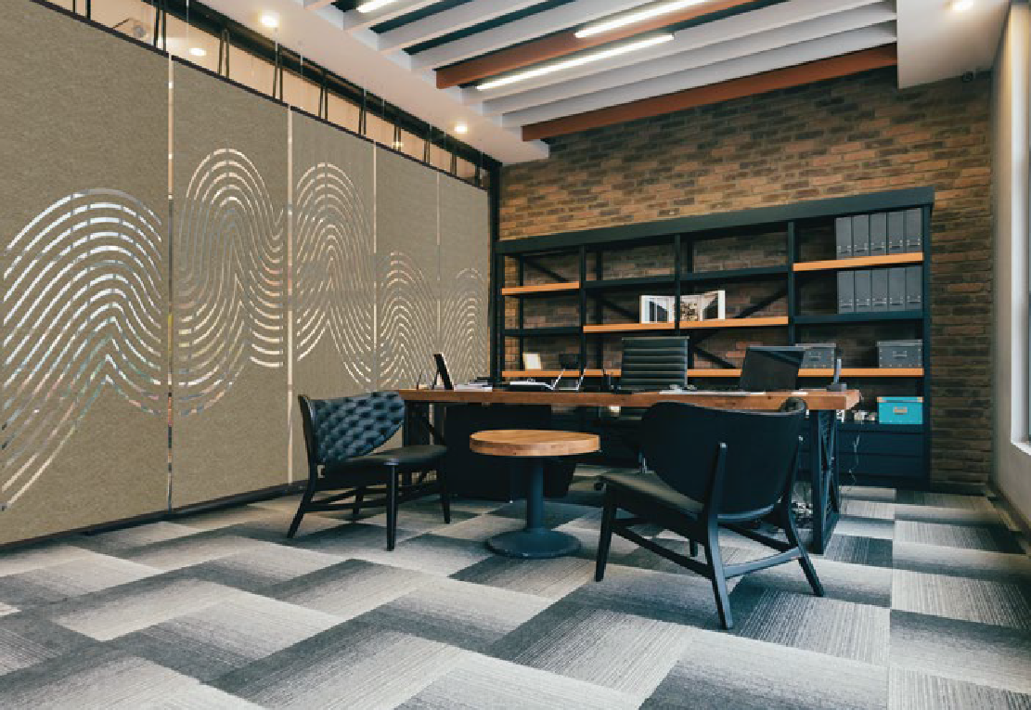
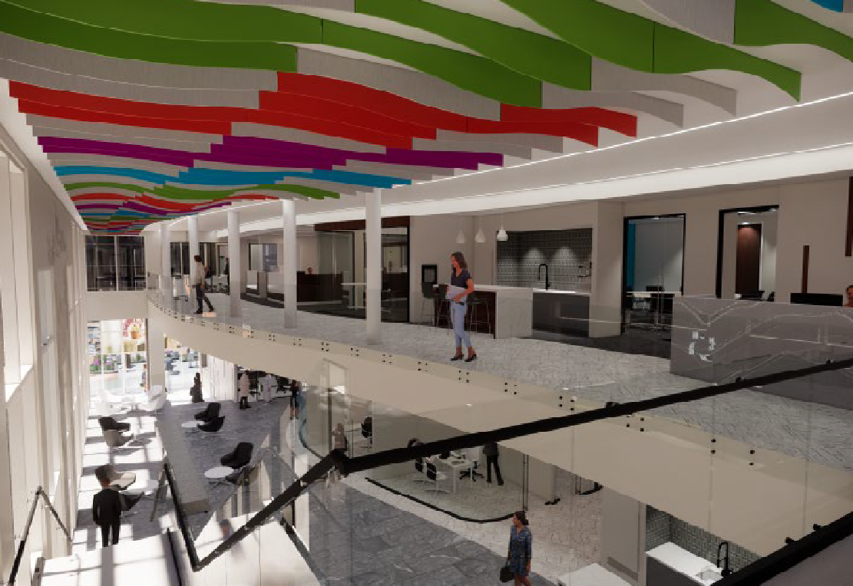
WHO WE SERVE
Work with architects, interior designers and general contractors to support projects from idea to installation.
You can find our work in...
Corporate interiors
Hospitality
Healthcare
Restaurant
Education
Retail

Slide 8
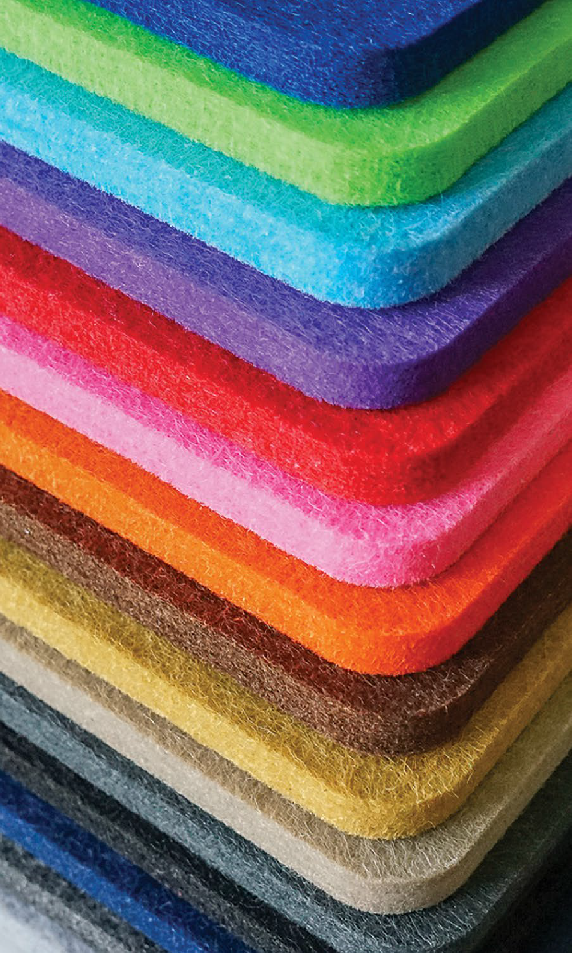
Acusti·fiTM
We utilize Acusti·fi (ah-coo-sti-fi) PET felt to craft beautiful and functional acoustic decor.
Sound-absorbing
Lightweight and slim (9mm)
Durable - Impact resistant
Cost-effective
Class A Fire rated
Water resistant
Made from 50% post-consumer content
100% recyclable
Available in 17 stock colors

Slide 9







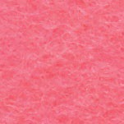



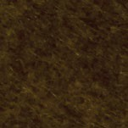


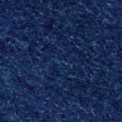


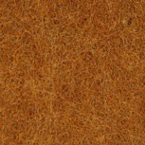
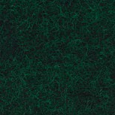
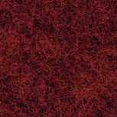

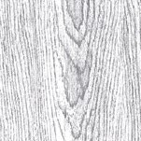
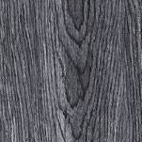
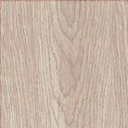
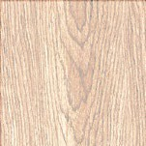
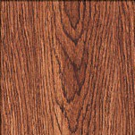
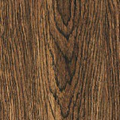
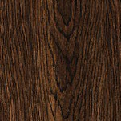



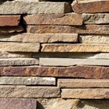
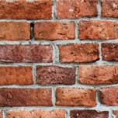
Acusti·fi
Available in 17 stock colors
Crystal | Alloy | Coal | Onyx | Pumice | Silt | Sandstone | Hibiscus | Garnet | Amber
(White) | PMS Cool Gray 8 C | PMS Cool Gray 11 C | PMS Black C | PMS 4022 C | PMS 1255 C | PMS 4243 C | PMS 211 C | PMS 186 C | PMS 165 C
Pebble | Oil | Amethyst | Lapis | Sapphire | Arctic | Seaweed | Copper | Pine | Red Blend | Canary
PMS 445 C | PMS 4625 C | PMS 512 C | PMS 2767 C | PMS 288 C | PMS 299 C | PMS 2300 C | PMS 731 C | PMS 5535 C | PMS 4102 C | PMS 7555 C
Wood grain textures
Weathered | Classic | Light Gray Oak | White Oak | Cherry Wood | Walnut | Dark Walnut
Gray | Gray Oak
Brick and stone
White Wash Brick
Smokey Gray Brick
Transparent Gray Concrete
Warm Slate
Aged Red Brick

Slide 10
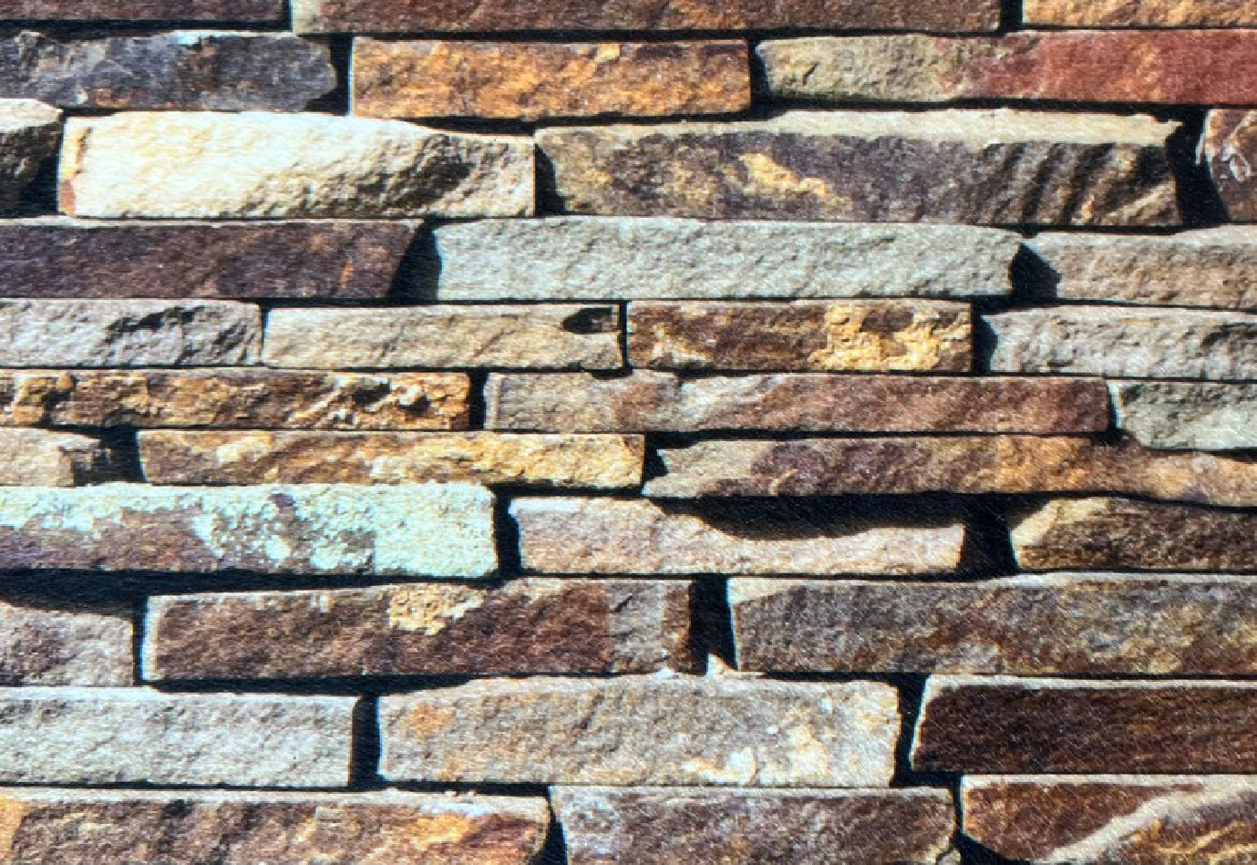

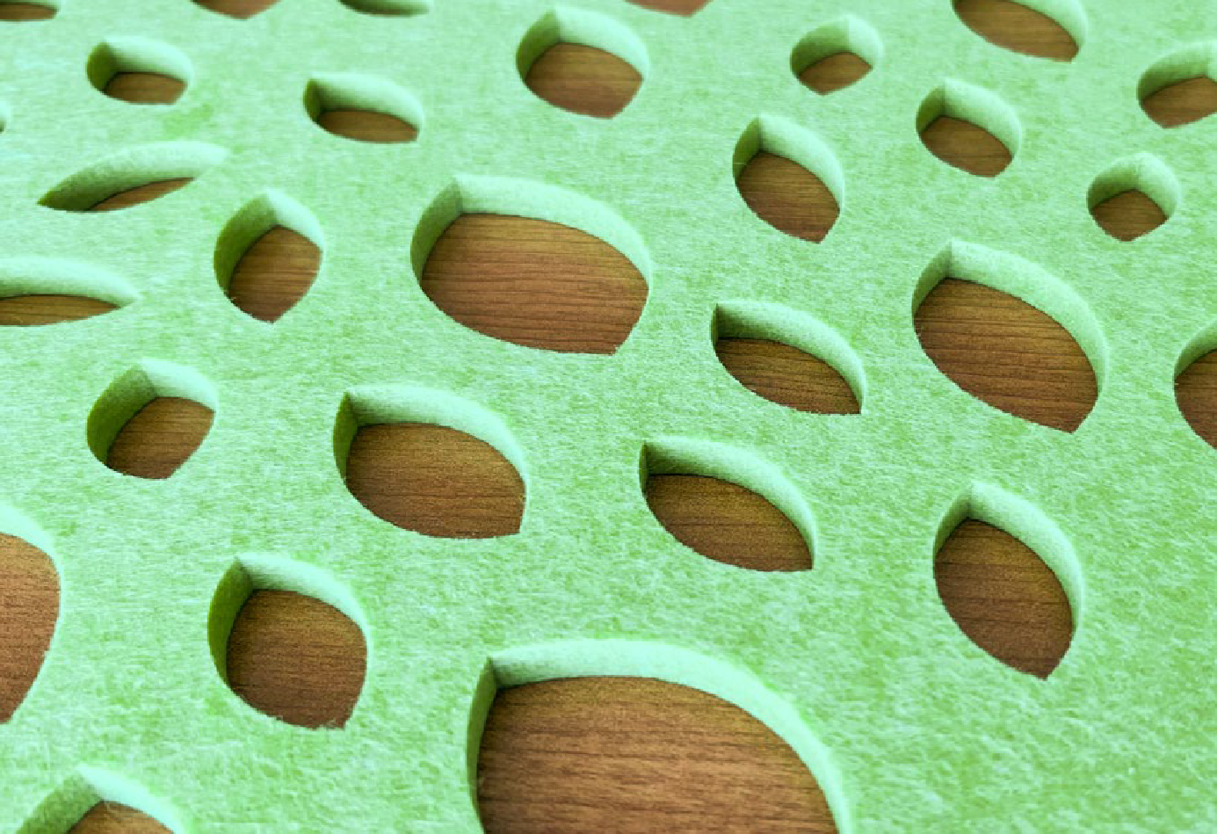
Acusti·fi
Finishing techniques offer the opportunity to personalize the material to best compliment the space or brand.
Printing
Carving
Cutting

Slide 11
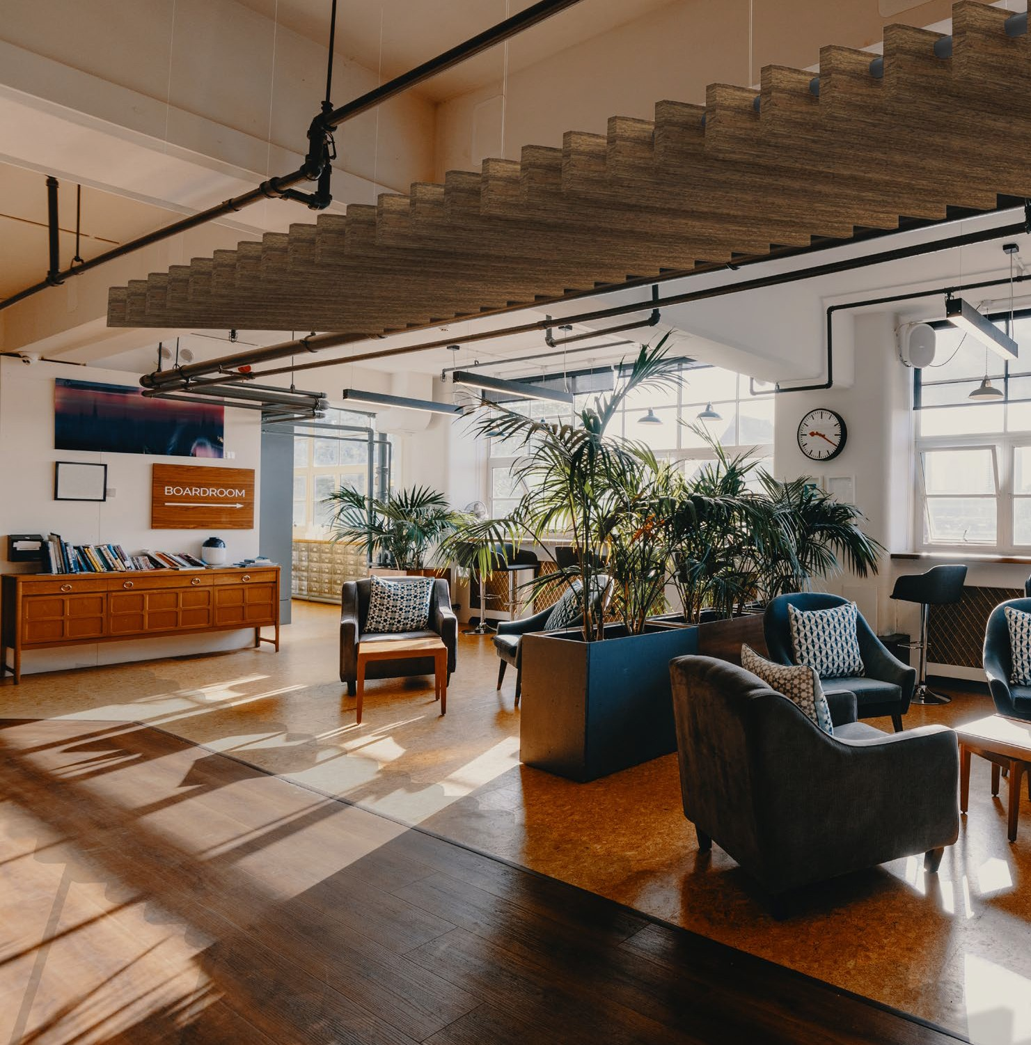
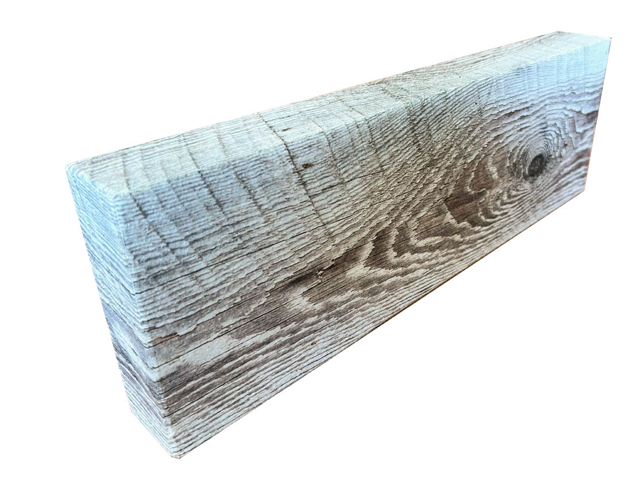
Acusti·fi
In combining high resolution digital printing and proprietary finishing techniques, the material can be shaped to recreate traditional materials.

Slide 12
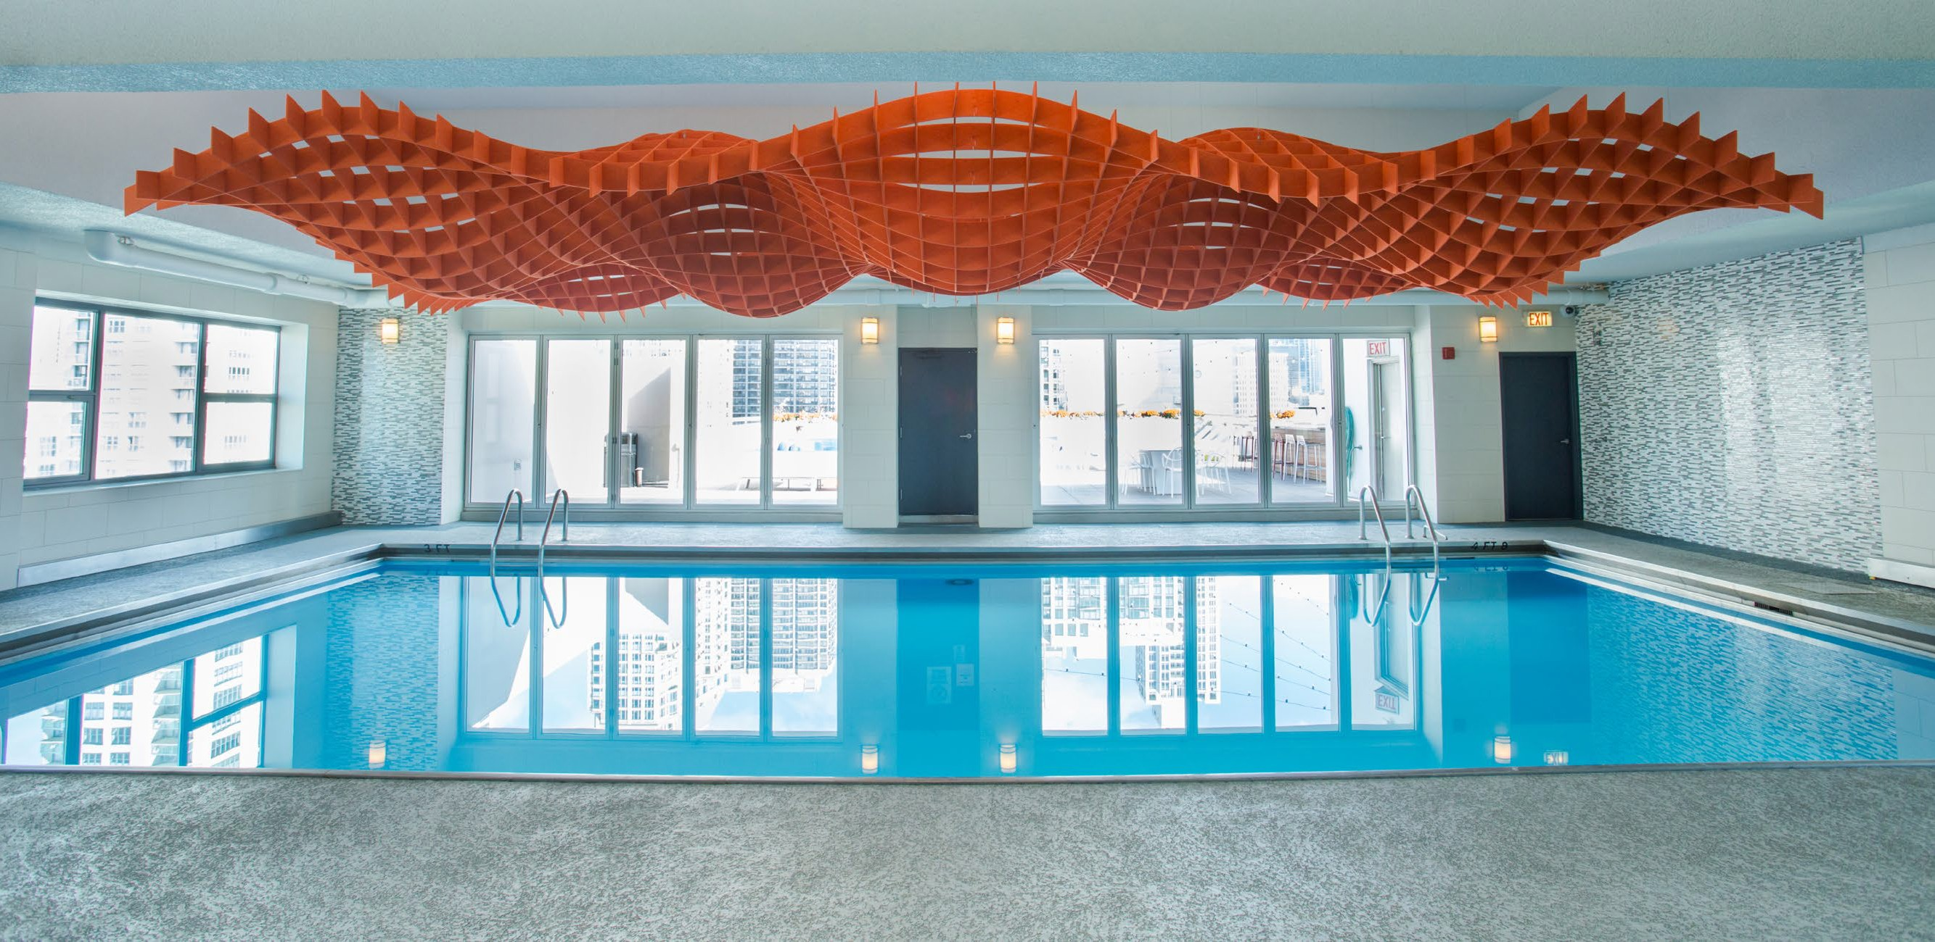

DUAL BENEFIT
Acoustical functionality
Visual impact

Slide 13
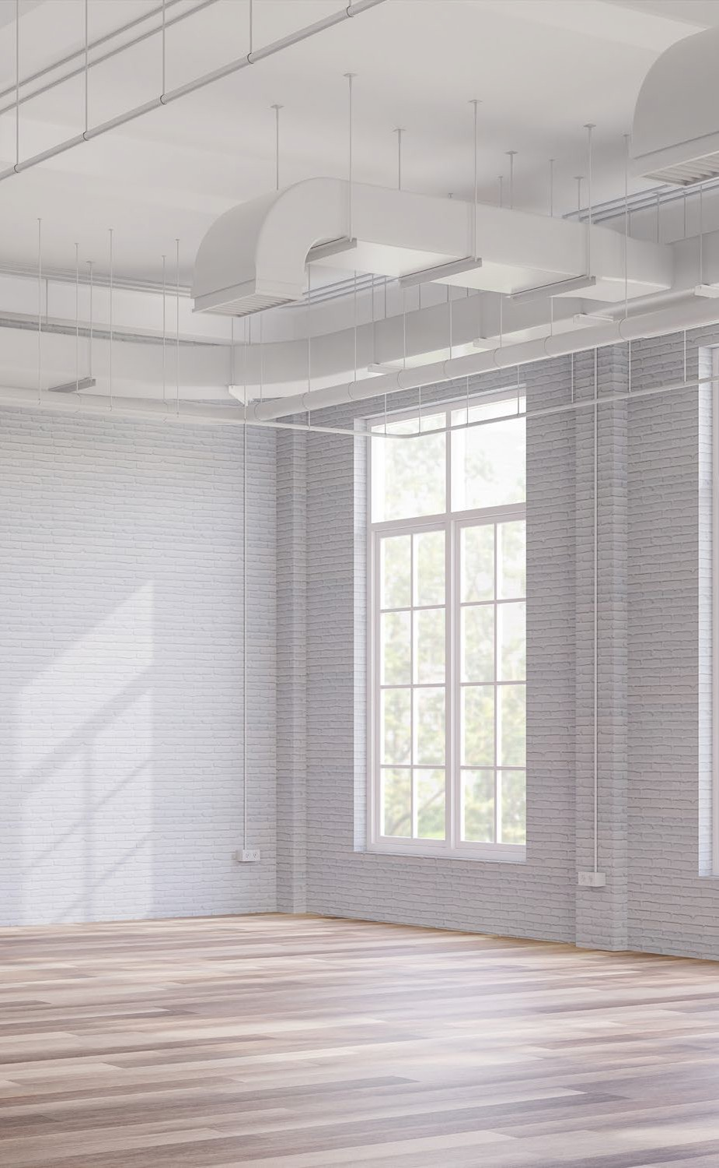
SOUND QUALITY
Acoustical issues can occur based on...
Open floor plans
Exposed high ceilings
Hard floors
Minimally decorated walls
Other hard surfaces
The result is...
Sound reflects off surfaces causing reverberation or echo.
Excessive noise or reverberation degrades sound clarity.
People experience the negative impact.

Slide 14
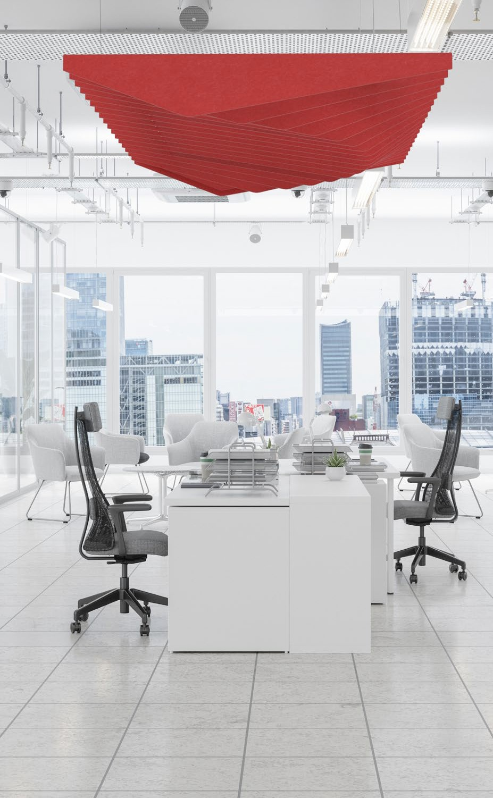

HEALTH & WELLNESS
Within these spaces, excess noise can lead to...
Distractions
Loss of productivity
Stress and anxiety
70% of employees said their productivity would increase if offices were less noisy.
Based on a study by ASID

Slide 15
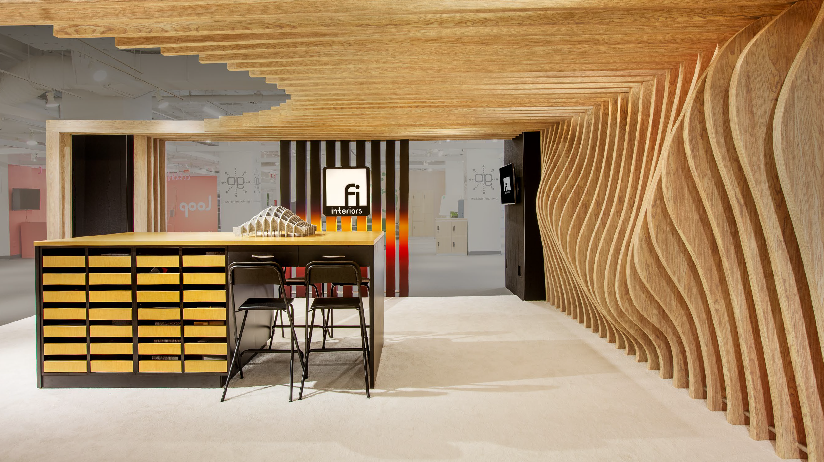
SOUND DAMPENING
PET felt, made from millions of compressed fibers, absorbs sound waves via tiny air pockets, dissipating the waves and reducing the overall noise in a space.
Achieves .98 NRC rating, which means 98% of sound is absorbed vs reflected.

Slide 16
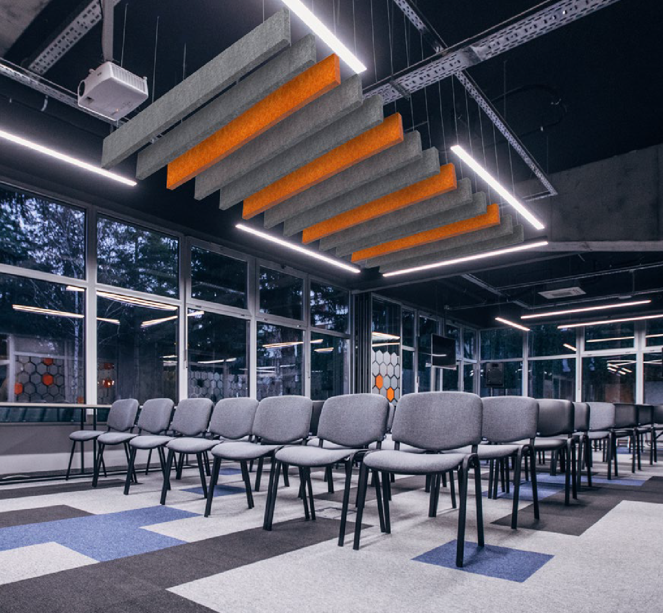
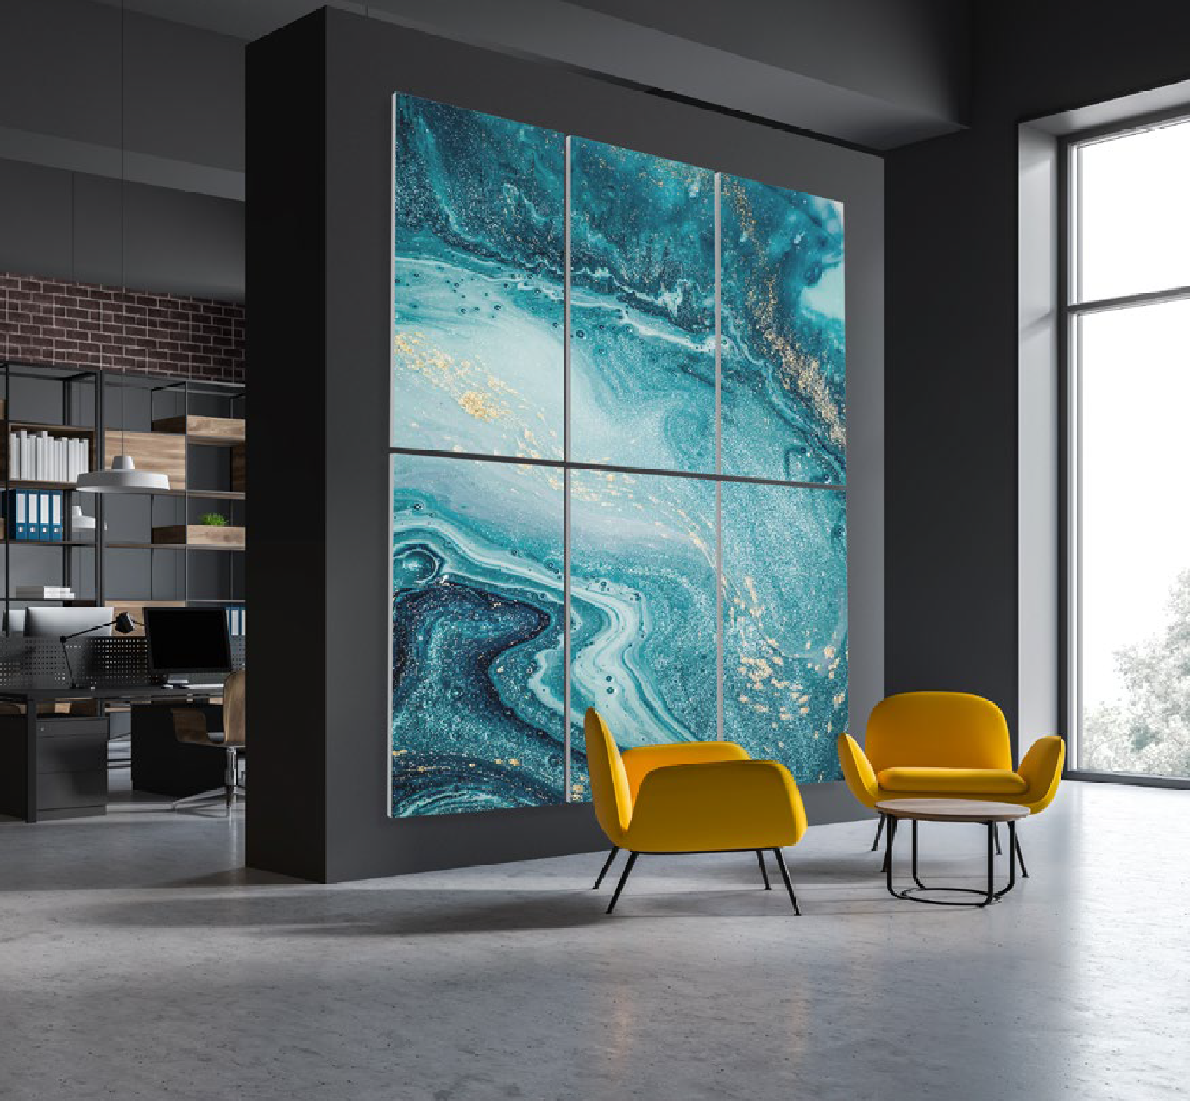
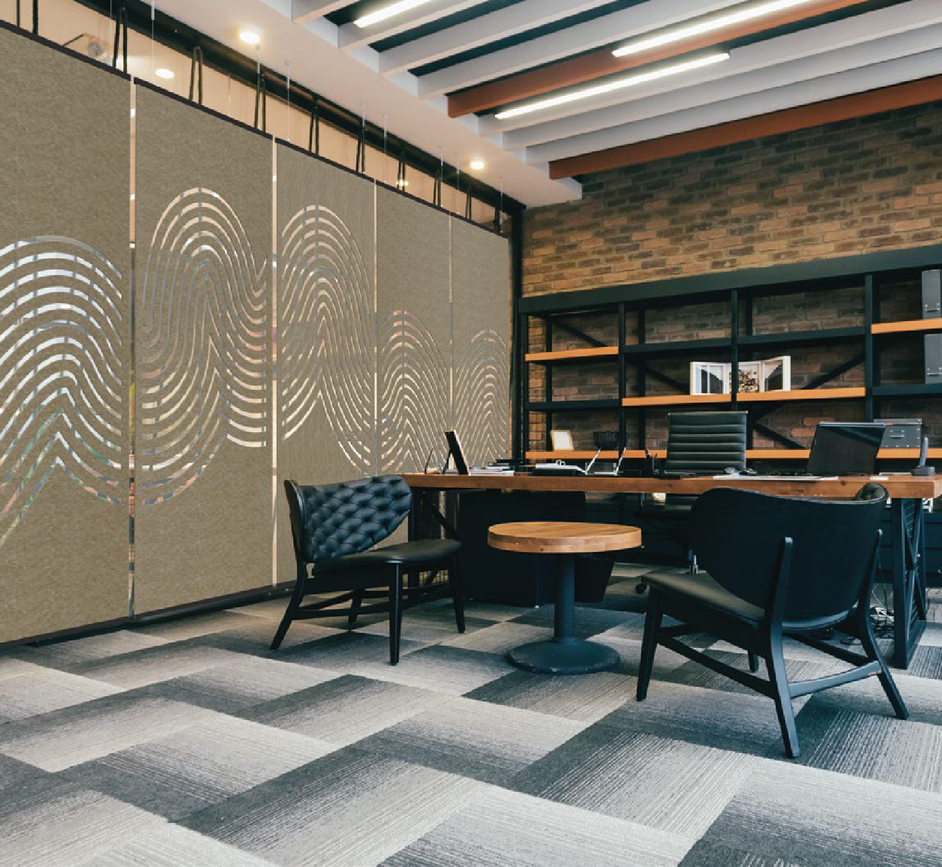
STATEMENT OF LINE
Made-to-order, easily tailored products that combine visual impact and acoustical functionality, covering three categories of interior décor.
Ceilings
Walls
Spacial Partitions

Slide 17
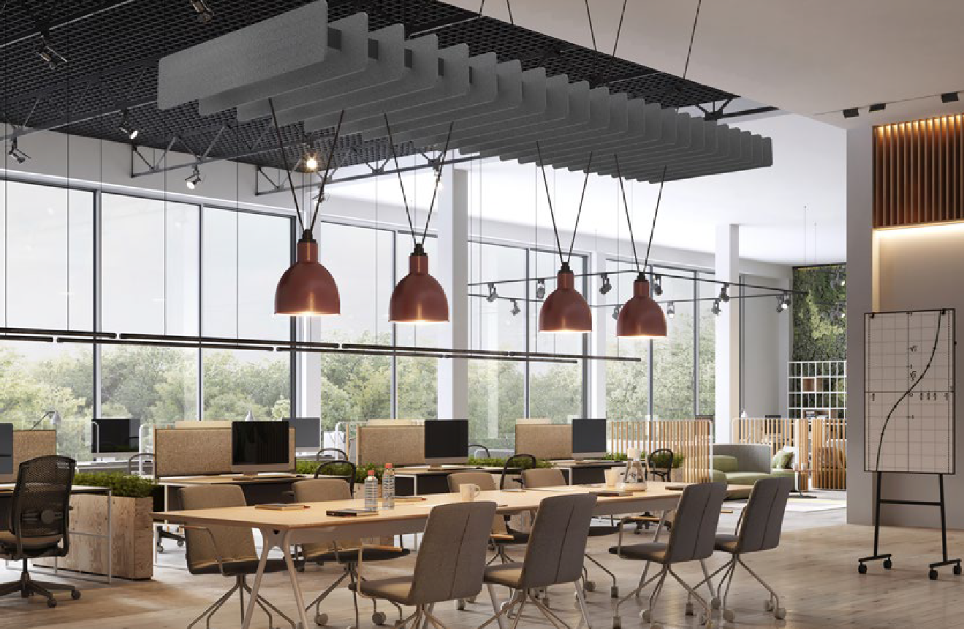
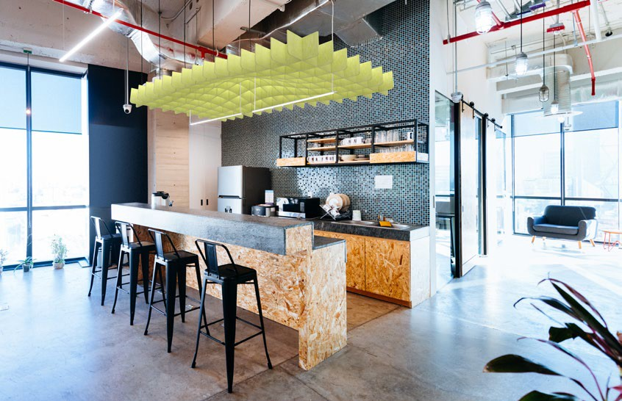
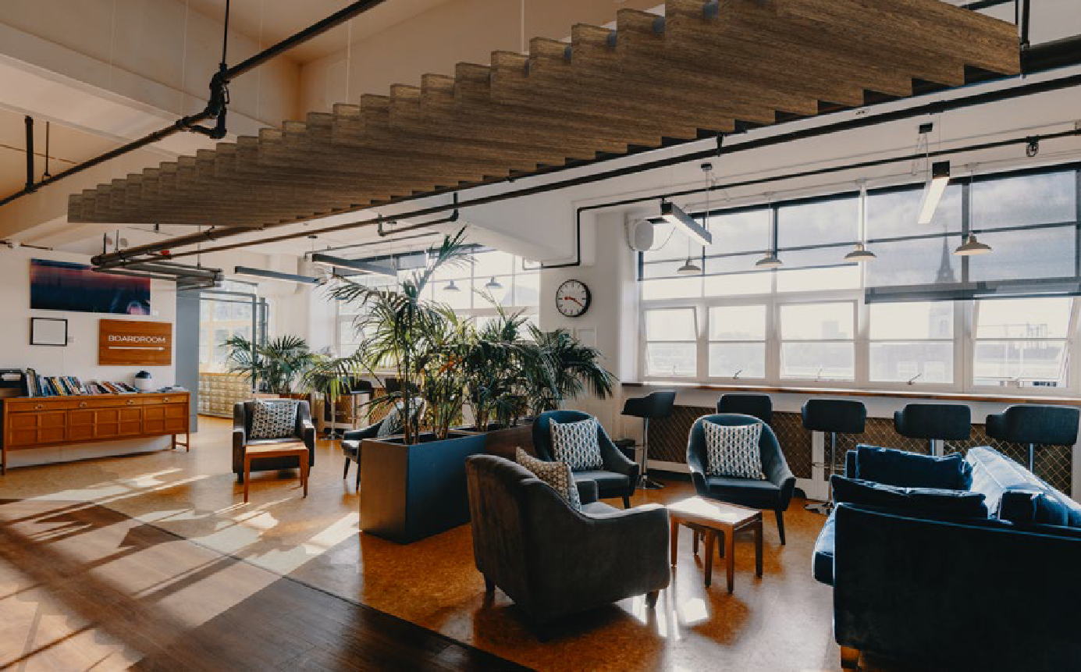
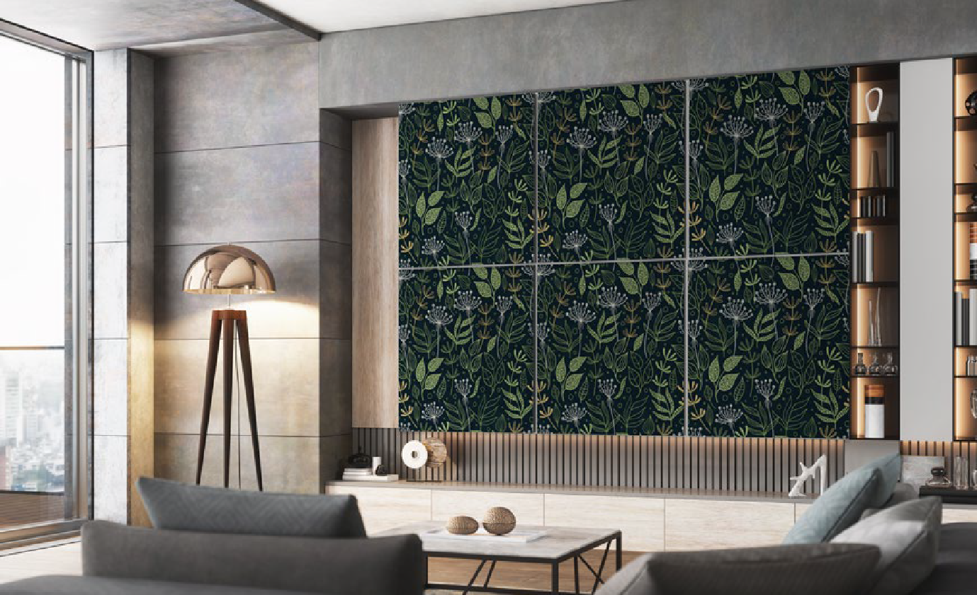
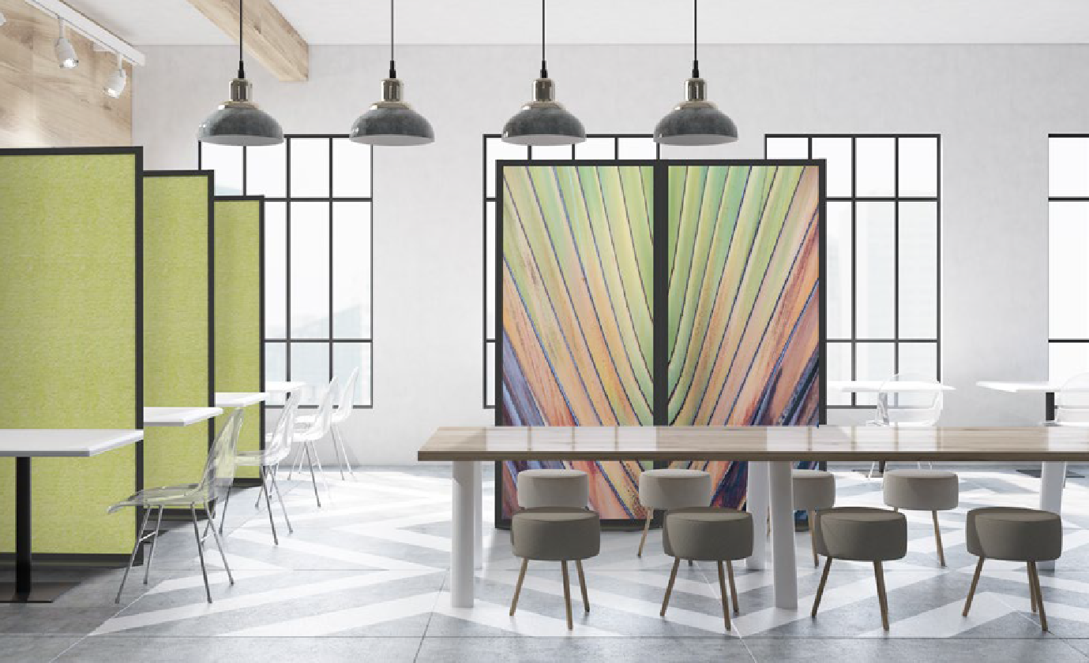
Beams
Baffles
Hatches
Wall Art
Spacial Partitions

Slide 18
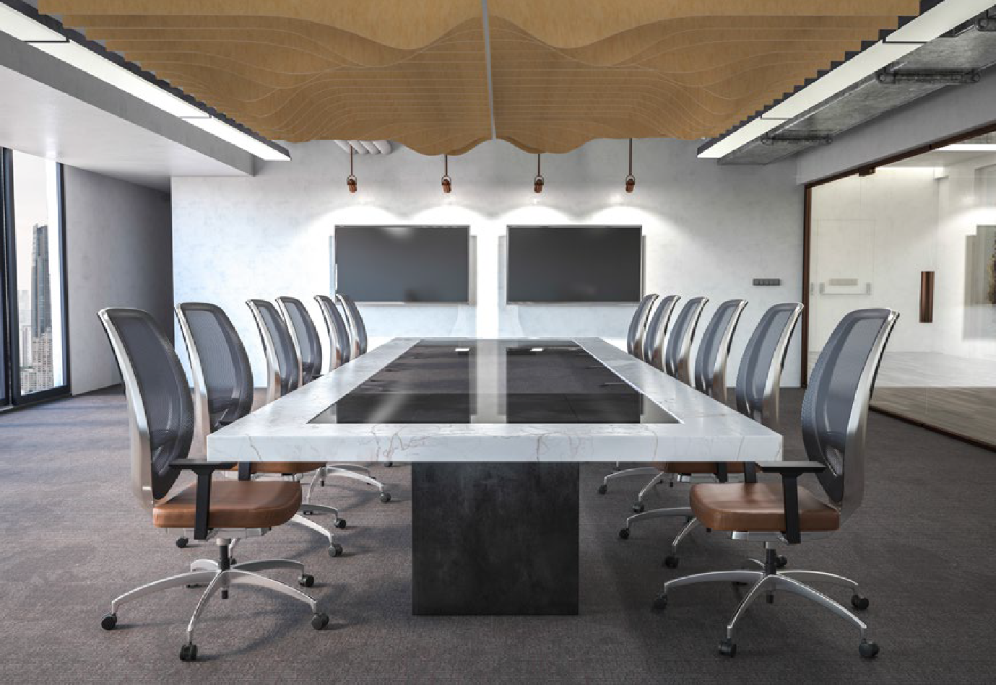
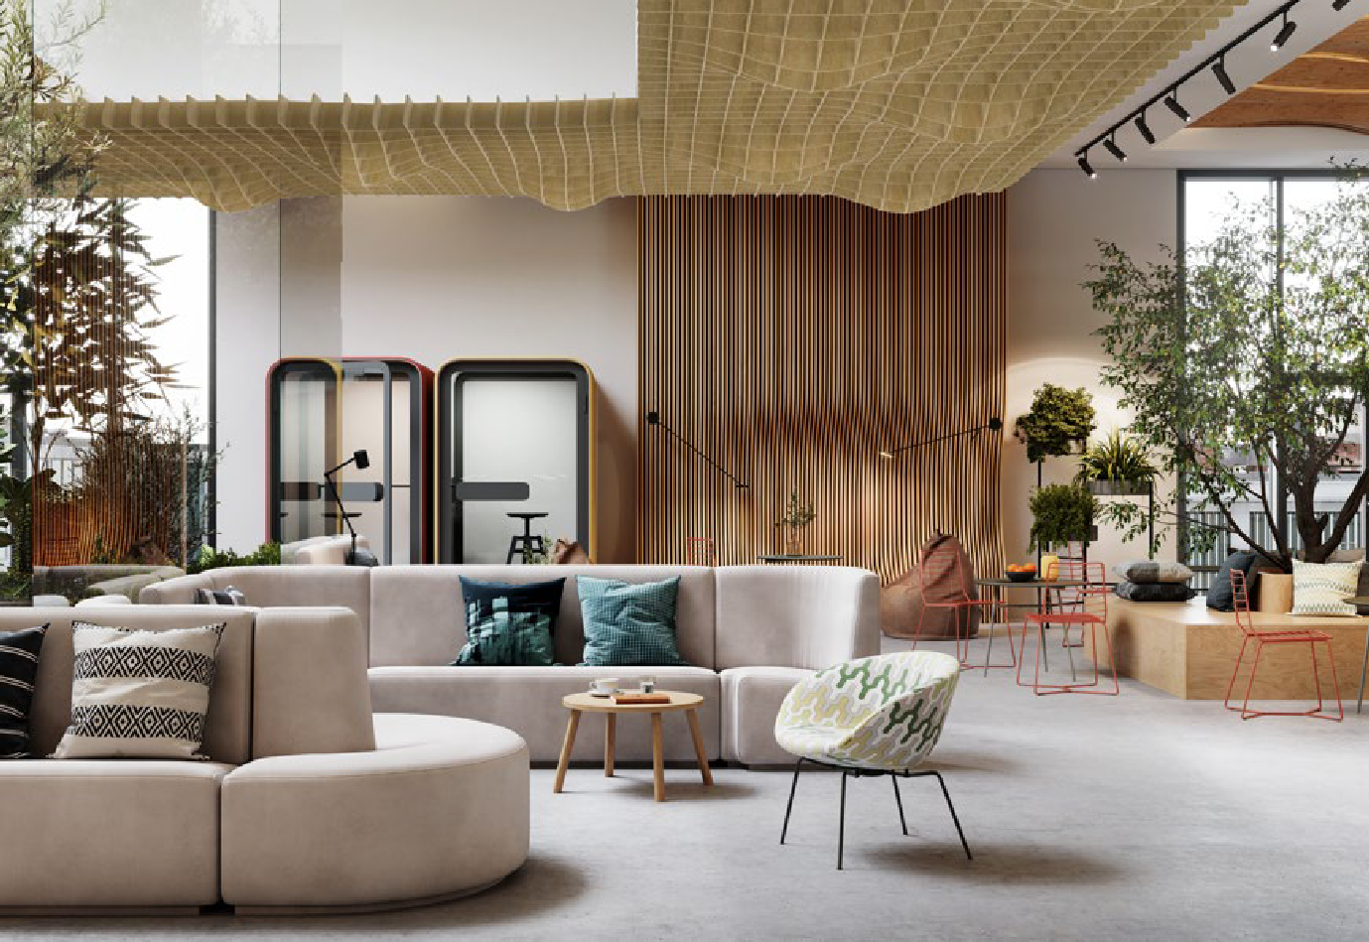
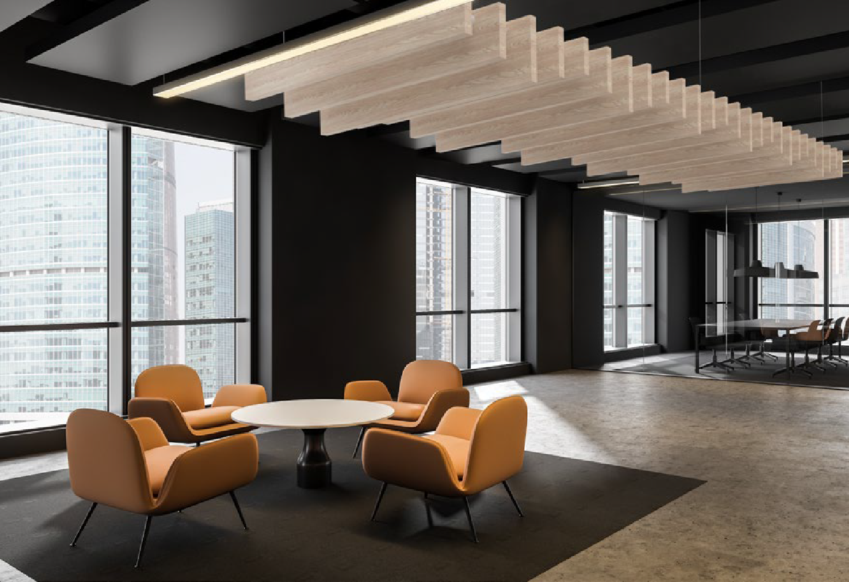
MODIFICATION
Products can be altered in size, shape, or color.
Single units can be combined to cover more area.
Mirrored Baffles
Extended HatchTM
Varied Beams

Slide 19
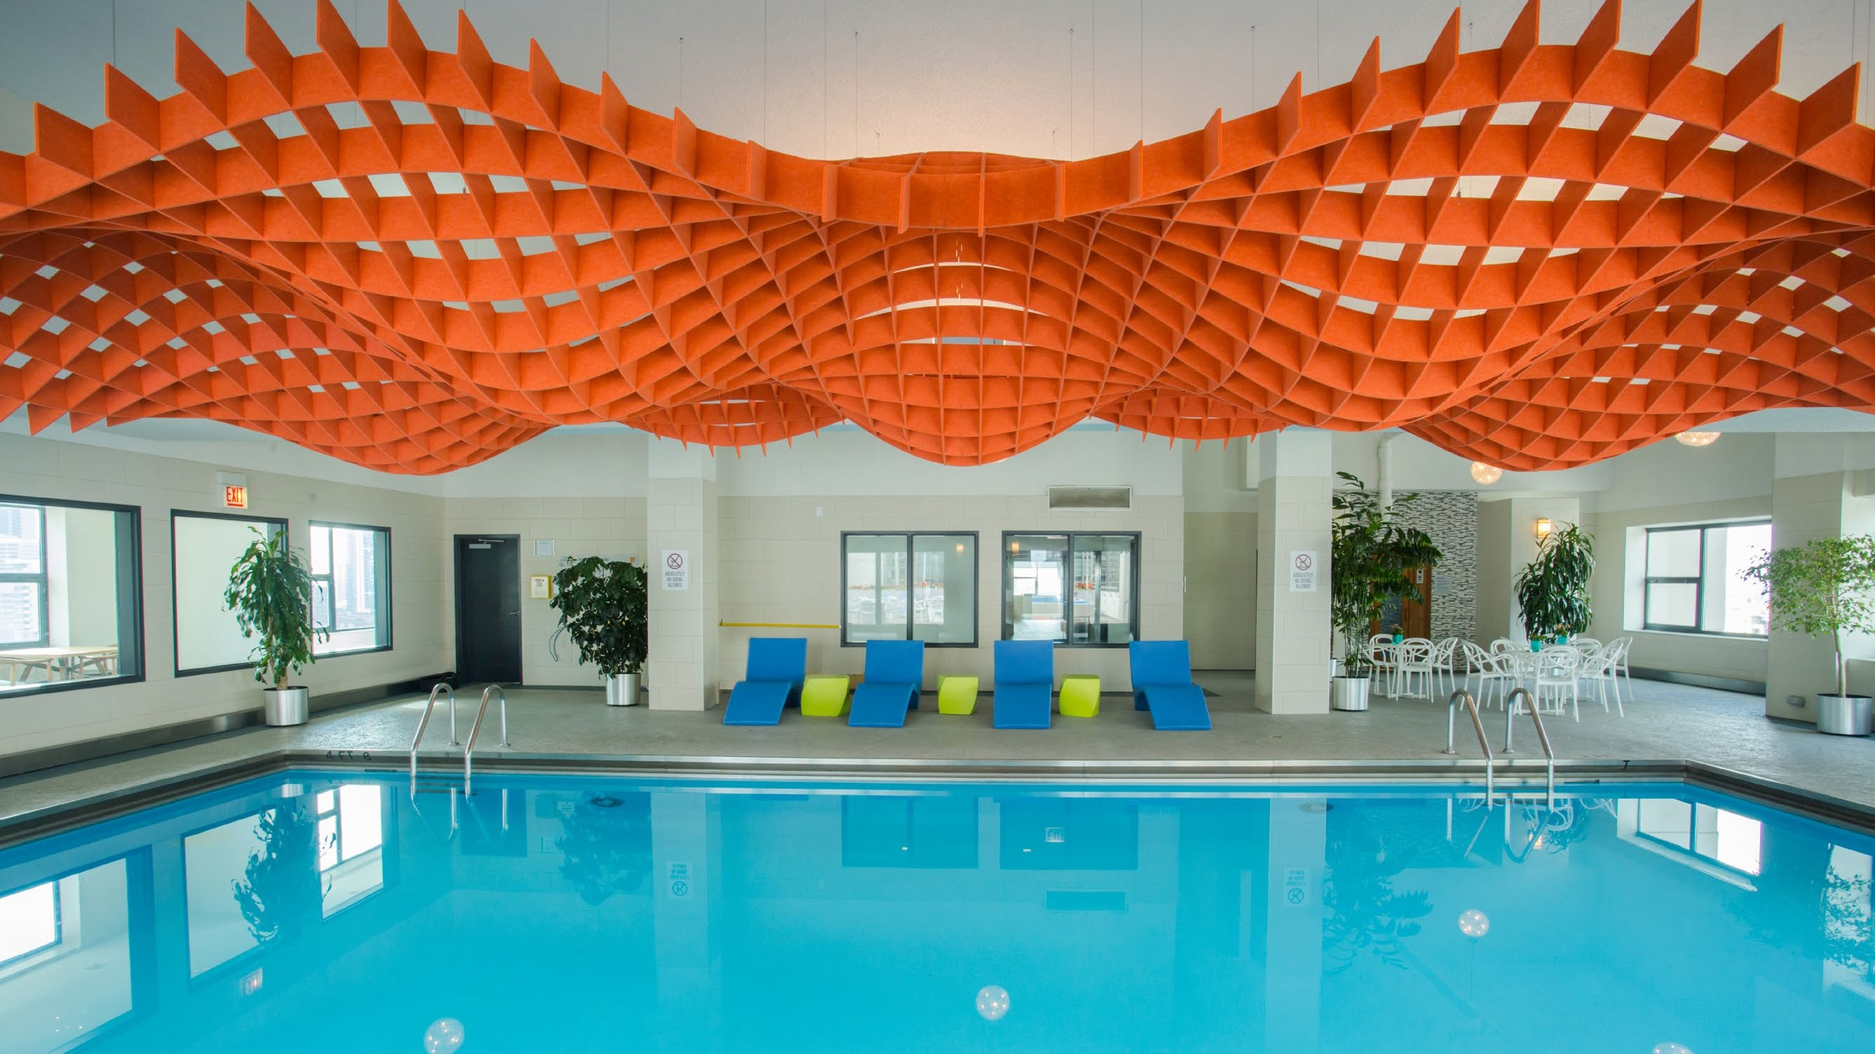
CUSTOMIZATION
Fully custom, one-off solutions developed to fit the essence, size, or budget of any space.

Slide 20
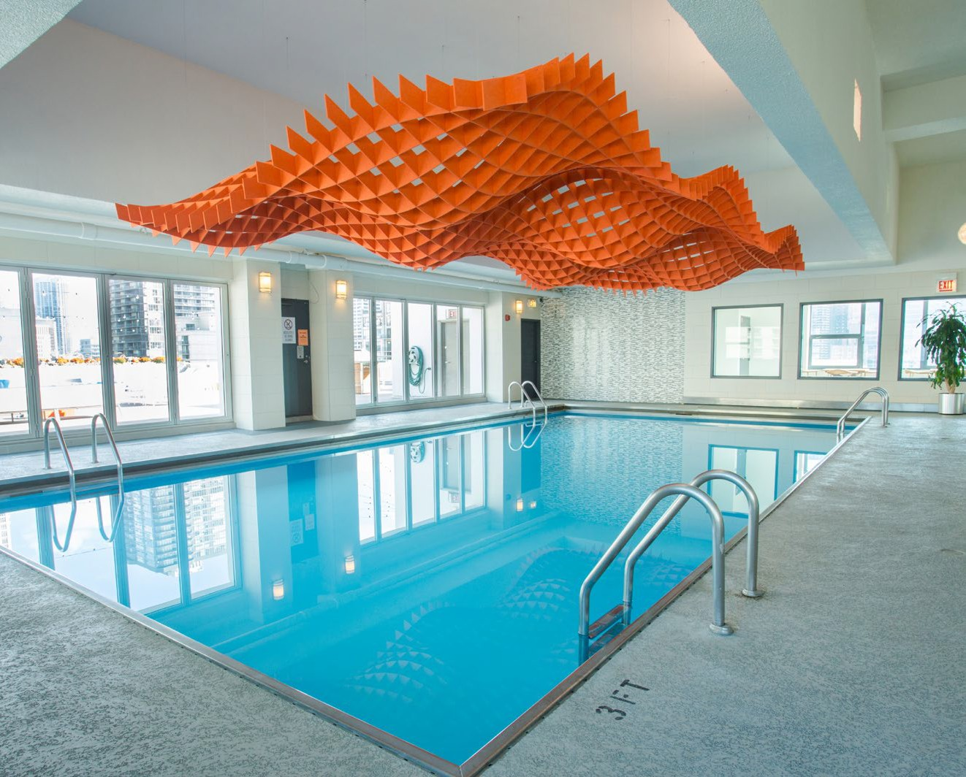

WEST 77 ROOFTOP POOL
Partnered with 4orm Studio of Chicago.
15’ x 30’ custom Hatch.
Organic wave-like shapes.
Bold contrast in color.
Captures sound in each cell.
Interacts with ambient light.

Slide 21


INSPIRATION
Starting with the basic hatch...
Expanded in size
Curved into waves

Slide 22



INSTALLATION
Pieces are grouped and labeled, then packed according to the order of installation.

Slide 23

CUSTOM PROCESS
Each custom project goes through a similar process that helps us understand and guide the vision from concept to completion.
Step 1: Quote
Discuss scope, budget and timeline.
Submit drawings, photos, renderings, dimensions.
Proposal and quote provided.
Step 2: Order
Order and deposit received.
Project Manager assigned.
Shop drawings produced for approval.
Final approval received.
Step 3: Production
Final in-hands date confirmed.
Installation and delivery discussion.
Production begins.
Step 4: Delivery
Delivery location confirmed.
Final payment received.
Project delivered.
Step 5: Realization
Installation support.
Project is completed to customer satisfaction.

Slide 24


INIS PERFUMERY
Partnered with Retail Rehab.
600 square foot retail space.
Custom Acusti-fiTM beams and baffles.
Gradient coloring to simulate waves.
Wood grain textured beams.
Metal framing for support.

Slide 25



PROJECT SUPPORT
The client submitted an original design inspired by the standard ExposureTM beams and Level DuneTM Baffle.
In collaboration with our design team, it evolved to feature longer two-directional beams and the Level GlacierTM baffle to better simulate waves.
During the design process, installation details were reviewed and the solution is engineered for easy implementation.
Shop drawings were created to depict assembly and give the general contractor step-by-step instructions for installation.

Slide 26

HIGHLIGHTS
Helped avoid a standard grid-ceiling.
Complimented Inis with a one-of-a-kind, brand consistent visual statement.
Improved acoustics, cutting down on reverberation.
Materials aligned with the clients sustainability values and goals.

Slide 27


REUNION
Partnered with Knauer and Chas Bender.
1,000 square foot dining room.
Custom Acusti-fiTM beams and panels.
Custom reclaimed wood textures.
HVAC and lighting integration.

Slide 28



PROJECT SUPPORT
Developed protoypes of the beams and panels to demonstrate construction and print quality.
Collaborated with General Contractor to determine the installation method and engineer the solution for easy retrofitting of the existing space.
Developed a detailed plan for installation that included packing and labelling componants based on zones and the order they would be installed.

Slide 29

HIGHLIGHTS
Value engineered a custom solution that cut 30% off the initial quote amount without sacrificing the original vision.
Seemless collaboration with the General Contractor led to a smooth installation.
Custom textures were randomized to avoid a repeating pattern within the ceiling panels.

Slide 30


KELLER STATION
Partnered with Lincoln Office.
1,000 square foot office space.
Brick textured wall covering.
Custom 10” x 10” Acusti-fiTM beams with 4” brackets and hardware detail.
Concept tapped into building history.

Slide 31


PROJECT SUPPORT
Met with client and provided past project references, which inspired the beam concept.
Shipped material/beam sample for review.
Reviewed their existing ceiling plan and designed the structure to work around structural beams and HVAC components.
Developed easy to install sections and plan for zoned installation. Detailed instructions showed pick points and assembly steps piece by piece.

Slide 32

HIGHLIGHTS
Our lightweight solution allowed the client to tap into the history of the building and create railroad tie inspired beams.
Metal detail/bracket incorporated for authenticity.
Installation went smoothly based on the plan.

Slide 33


OED SHOWROOM
Custom 10’ x 20’ HatchTM.
Brand-inspired hanging partitions.
Brick textured enclosed pillars.
Beams with integrated lighting.
Mirrored Level GlacierTM Baffle.

Slide 34



PROJECT SUPPORT
Reviewed space for potential product inclusion.
Designed custom tailored options for different areas of the showroom based on the total aesthetic of that space.
Supported installation with recommendations and detailed instructions for assembly.

Slide 35

HIGHLIGHTS
Highlights a range of products within one space, demonstrating the various form factors the material can take on and how it can impact the visual aesthetic of the space as well as the acoustical functionality.

Slide 36


NEOCON 2022
Designed and built by Fi Interiors.
458 square foot exhibit space.
Incorporated Ombre style acoustic pillars.
Included overhead beams that morphed into parametric wall.
Integrated lightboxes and backlit graphics.

Slide 37



HIGHLIGHTS
Visitors consistently read the Acusti-fi beams as real wood, comfirming the success of the print quality and finishing.
The combination of the parametric wall and lightbox graphic created a rainbow effect reflected across the beams, which was visible from both sides and drew visitors in for a closer look.
The acoustic felt dampened the overall noise in the space, creating a quieter environment for conversation.

Slide 38


LET’S WORK TOGETHER
We want to be your go-to manufacturer for acoustical interior décor.
In collaboration, we can provide your clients with quality products
that are visually stunning, environmentally sustainable, and acoustically capable of improving the comfort and wellness of those using the space.
www.fabricimages.com/fi-interiors
©2022 Fabric Images, Inc.® All Rights Reserved.

